Slide 1
Scheduling & Priority System for Autonomous Vehicles
Prof. Ohn-Bahr
EC535
Final Project
01 May 2025

Slide 2

Project Objectives
Design a Real-Time system simulating task scheduling in Autonomous Vehicles
Simulated Tasks
Braking
Sensor Scanning
Path Planning
Vehicle Control
Communication
Data Logging
Prioritize braking and steering interrupts with hard deadlines, give communication and path planning lower priority designations

Slide 3
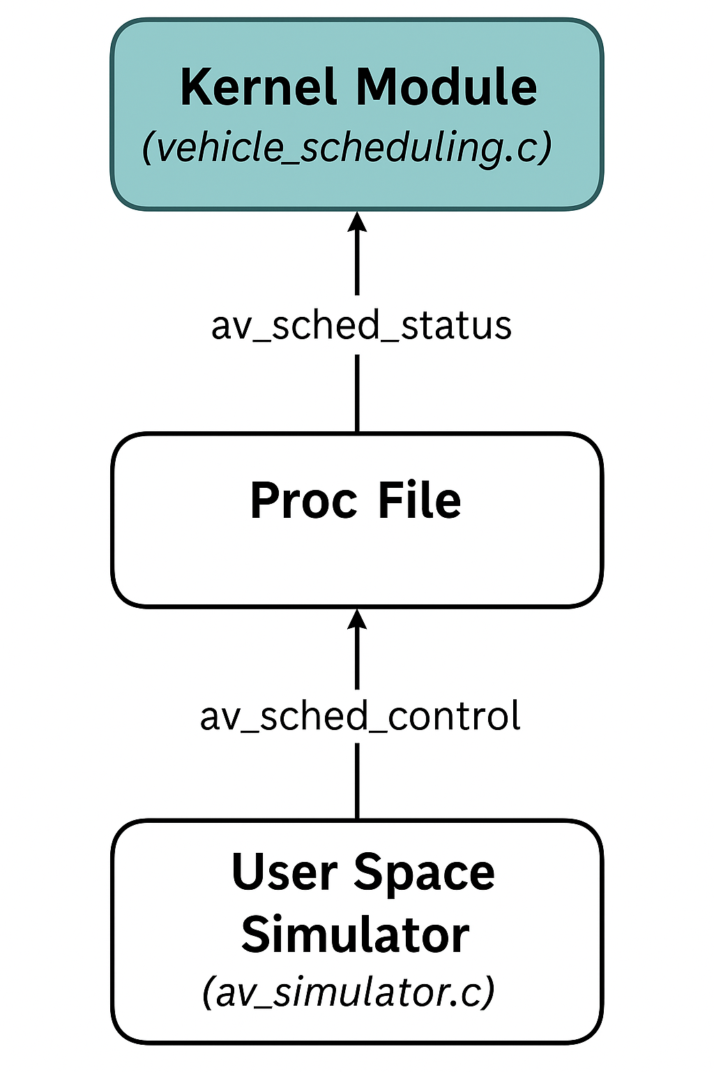
System Architecture
Kernel Module
Task threading
Real-Time Scheduling Policy
Responds to /proc interface
Tracks + Reports task deadlines & statistics
Userspace Program
Simulated AV environment (obstacles, task activation)
Trigger emergency brake + other tasks
Process file Interface
Av_sched_status - outputs current state of each task
Av_sched_control - accepts simulated inputs from userspace program

Slide 4
AV Tasks Modeled
A
B
C
D
E
F
Emergency Braking
Hard Deadline
Immediate Response, other threads are dropped
Sensor Scanning
Soft Deadline
Periodic activation, object scanning and environment scanning
Path Planning
Soft Deadline
Periodic activation, Route Planning & Adjusting
Vehicle Control
Hard Deadline
Immediate response, Steering, Speed Adjustments
Communication
Soft Deadline
Periodic activation, Vehicle to database, satellite etc.
Data Logging
Soft Deadline
Periodic, records events

Slide 5

Real-Time Scheduling
Emergency Brake + Control
SCHED_FIFO99
Other Tasks
SCHED_OTHER
Each Task runs in its own Kernel Thread
Thread waits on events
Time budgets for each event enforced using ktime

Slide 6

Braking Interrupt
Braking Interrupt Triggered
Object detection simulates object in the way
Event notifies braking thread immediately
Soft-deadline tasks on hold until emergency brake disengaged
Thread Communication
Shared flags
Wait Cues

Slide 7

Input Simulator
Included CLI program to simulate events during driving
Sends commands via /proc/ file
Simulated object detection
Start/Stop of tasks
Randomized input
Included test program in Github Repository to simulate these inputs rapidly
Instructions included in ReadMe + Video

Slide 8

Video Demo
Shows the test script being run with Kernel Mod inserted

Slide 9
Github

